Slide 1
Magnetic Gear
10
Ondřej Sedláček
FOR TEAM GCHD

Slide 2
Table of contents
Introduction
Task definition
Relevant parameters and phenomena
Measuring spinner parameters
Determining drag
Simulation and testing
Driven spinner experiments
Magnetic coupling
Torque transfer

Slide 3
Task definition
Introduction
Take several identical fidget spinners and attach neodymium magnets to their ends. If you place them side by side on a plane and rotate one of them, the remaining ones start to rotate only due to the magnetic field. Investigate and explain the phenomenon.
We focused on the behaviour of 1 or 2 spinners, since anything above that starts behaving chaotically and is hard to quantitatively measure.
We always kept all the spinners in plane and firmly put in place, so that they‘d not move around.
We used identical spinners with identical magnets and magnet counts.

Slide 4
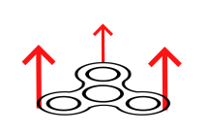
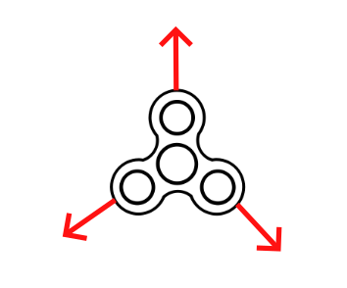
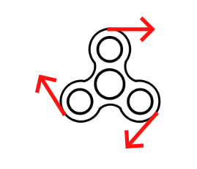
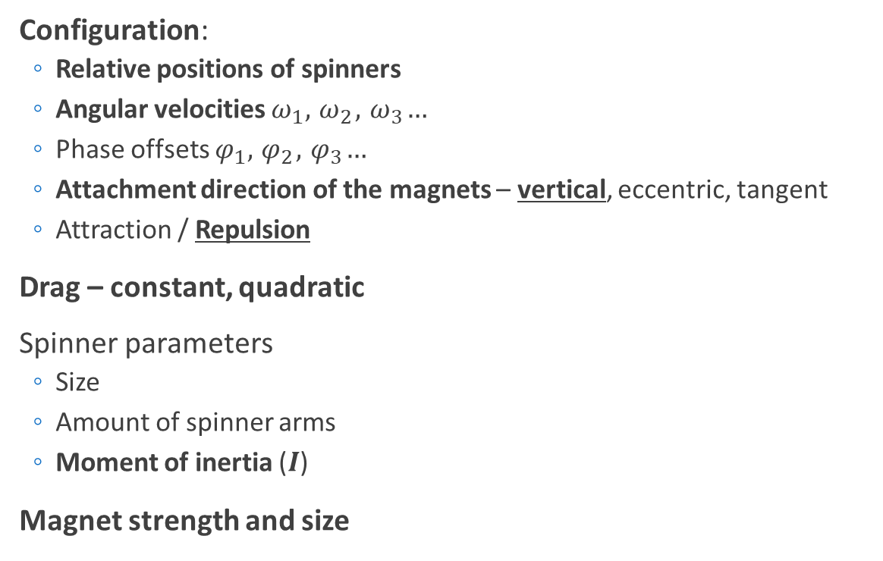
Relevant parameters
Introduction
Configuration:
Relative positions of spinners
Angular velocities $ω_{1},{ ω}_{2}, { ω}_{3}…$
Phase offsets $φ_{1},{ φ}_{2}, { φ}_{3}…$
Attachment direction of the magnets – vertical, eccentric, tangent
Attraction / Repulsion
Drag – constant, quadratic
Spinner parameters
Size
Amount of spinner arms
Moment of inertia ($I$)
Magnet strength and size
Vertical
Eccentric
Tangent
Notes:
We chose the vertical orientation, since it held on the easiest.
Other configuration might‘ve improved the torque tranfer, since B interactions are non-zero.

Slide 5
Some examples
Notes:
We should add some simple exmaples/videos, so that everyone catches on

Slide 6
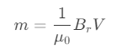
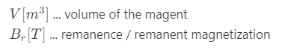

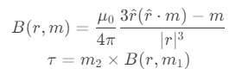
Relevant phenomena
Introduction
Magnet – magnet interactions
We used cube NdFeB magnets (5mm, grade N35)
We modeled each magnet as a magnetic dipole
Force interaction:
Torque due to generated magnetic field:
Other forces on the spinner:
Concentric forces on the ball bearing => increasing friction
Oscillations and rattling of the ball bearings
Magnetic dipole moment:
Notes:
Magnetic dipole approximation breaks down at small distances (comparable to the size of the magnet)

Slide 7
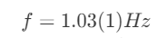
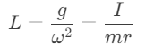
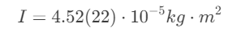

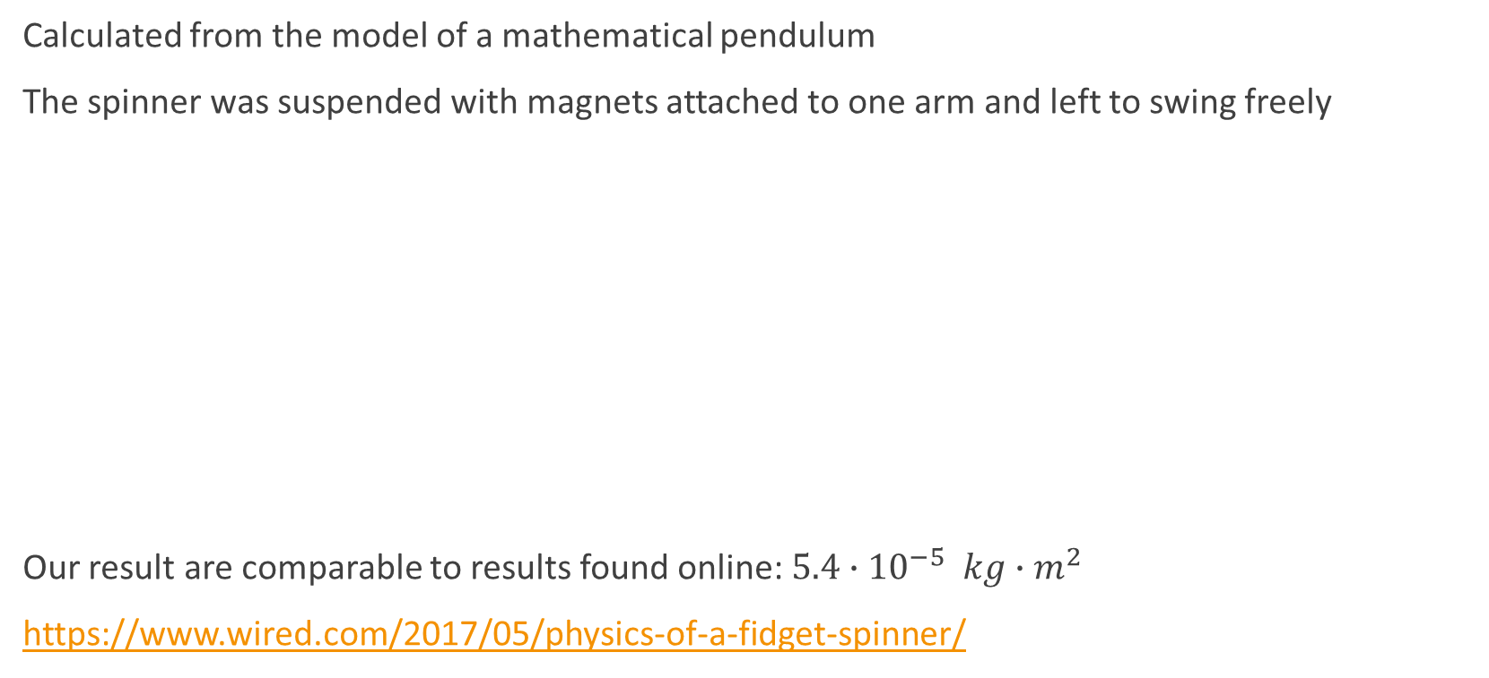
Moment of inertia $I$
Measurements
Calculated from the model of a mathematical pendulum
The spinner was suspended with magnets attached to one arm and left to swing freely
Our result are comparable to results found online: $5.4{∙10}^{−5} kg∙m^{2}$
https://www.wired.com/2017/05/physics-of-a-fidget-spinner/
Notes:
Moment of inertia = moment setrvačnosti
Angular momentum = moment hybnosti
Torque = moment síly

Slide 8
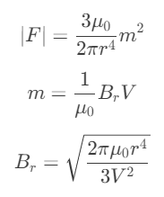
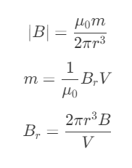
Remanence
Measurements
Can be either calculated from the generated magnetic field or from the force between the magnets
Simplifying the previous equations for dipole force and magnetic field:
We used both methods:
the force was measured via a scale (used for a singular magnet)
the field was measured using a mobile phone magnetometer (with the Earth‘s magnetic field being accounted for)

Slide 9
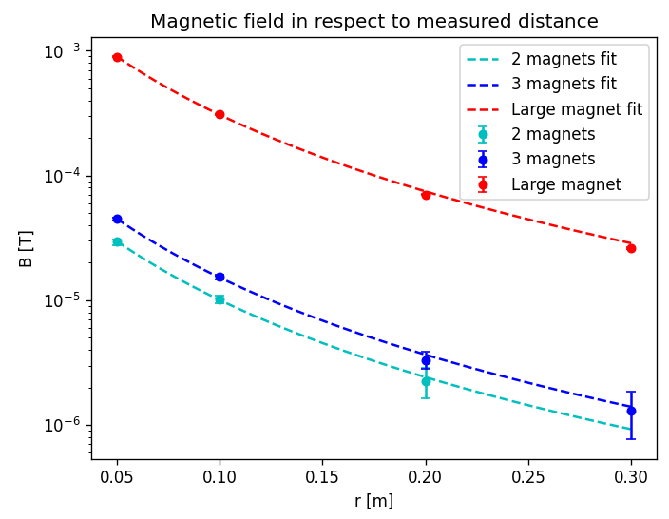
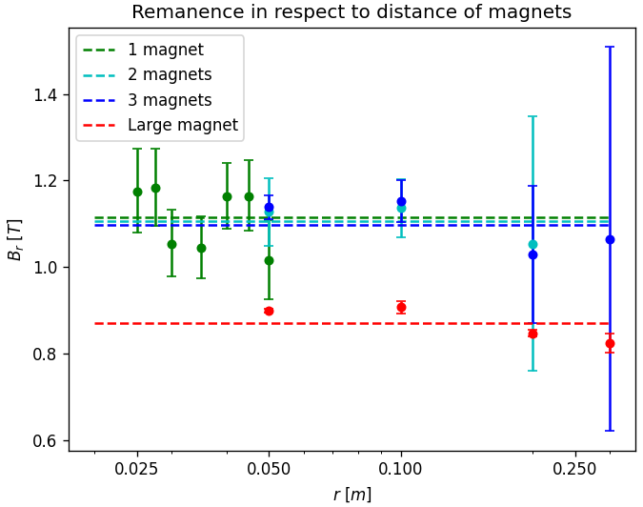
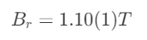
Remanence - results
Measurements
We measured for 1, 2 and 3 cube magnet stacks as well as a larger (old) NdFeB magnet

Slide 10
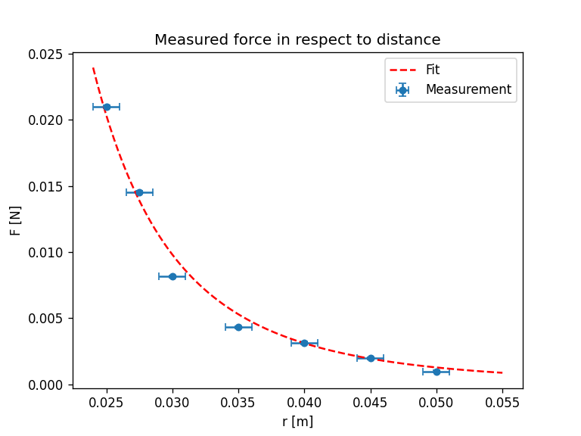
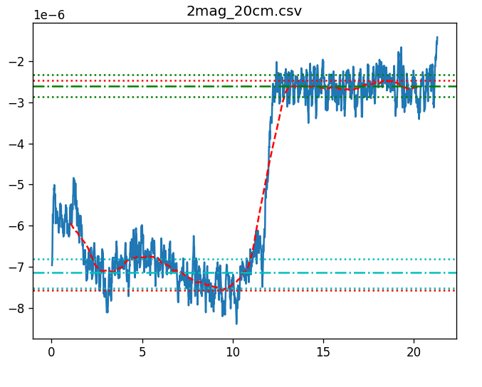
Remanence – more results
Additional information
B [T]
t [s]

Slide 11
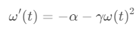
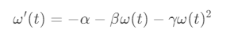
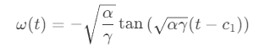
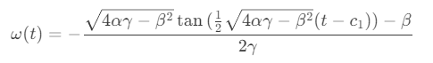
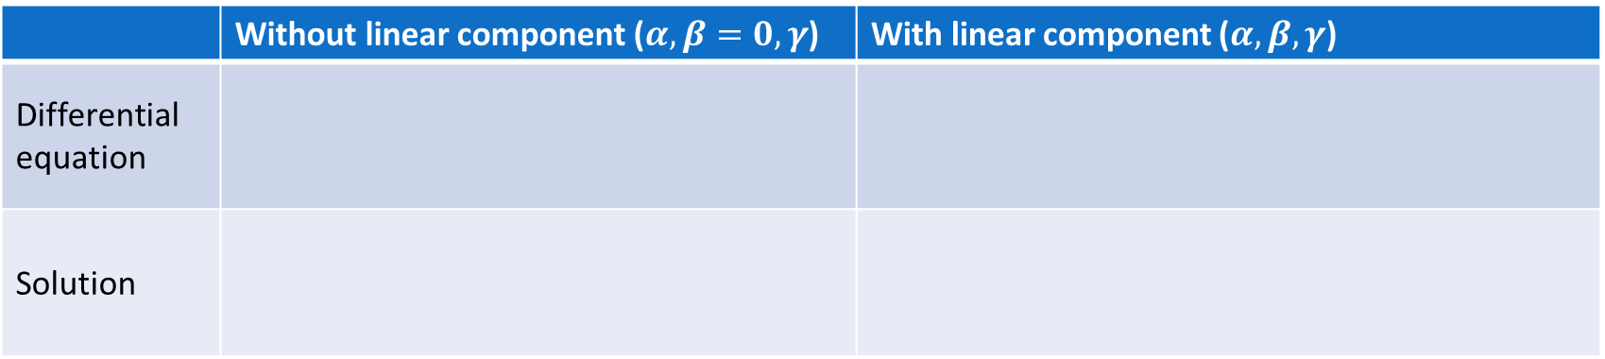

Drag
Measurements
Our theory suggests, that the main sources of drag would be:
Constant drag from the bearing friction – constant in respect to $ω$ (denoted $α$)
Turbulent drag on the spinner geometry – quadratic in respect to $ω$ (denoted $γ$)
(Possibly some linear component – linear in respect to $ω$ (denoted $β$))
$c_{1}$ … denotes the total time before the spinner stops
 | Without linear component ($α,β=0, γ$) | With linear component ($α,β,γ$)
Differential equation
Solution

Slide 12
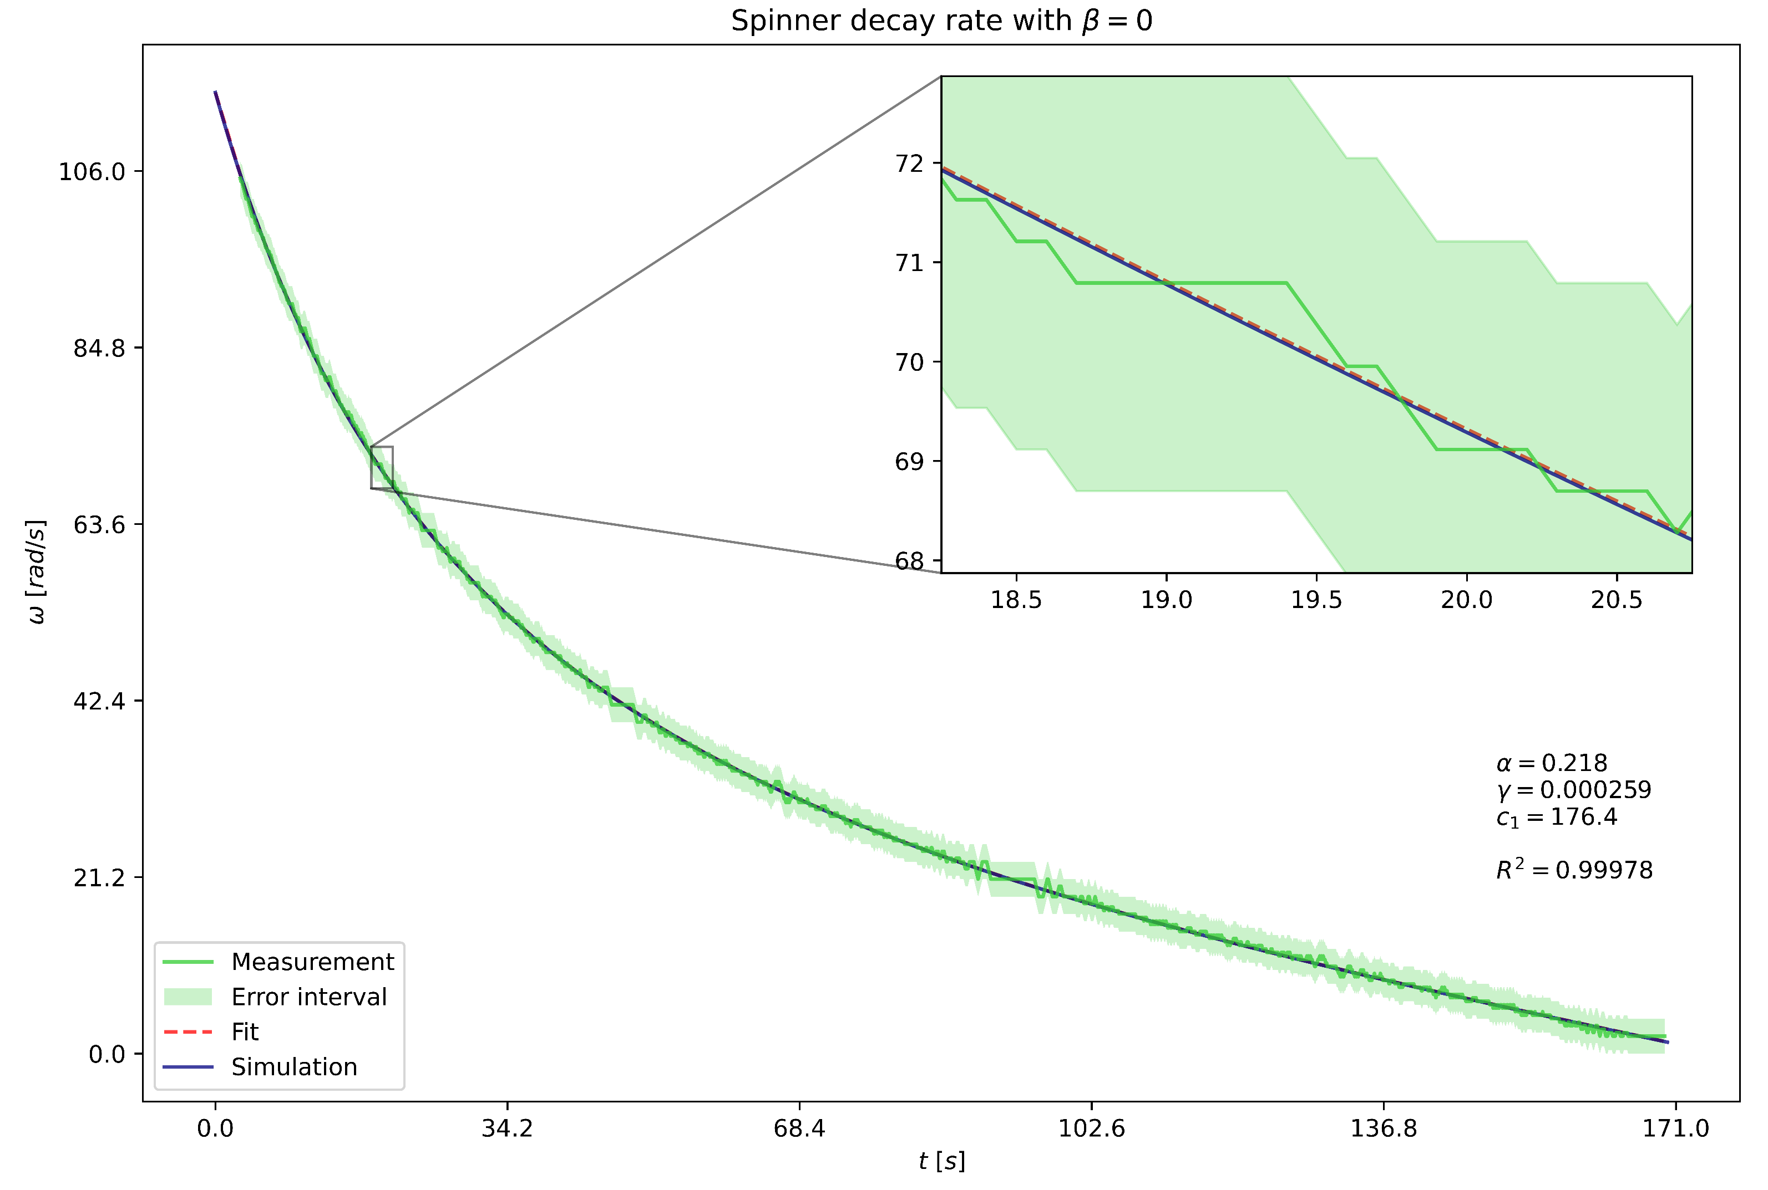

Drag - results
Measurements

Slide 13
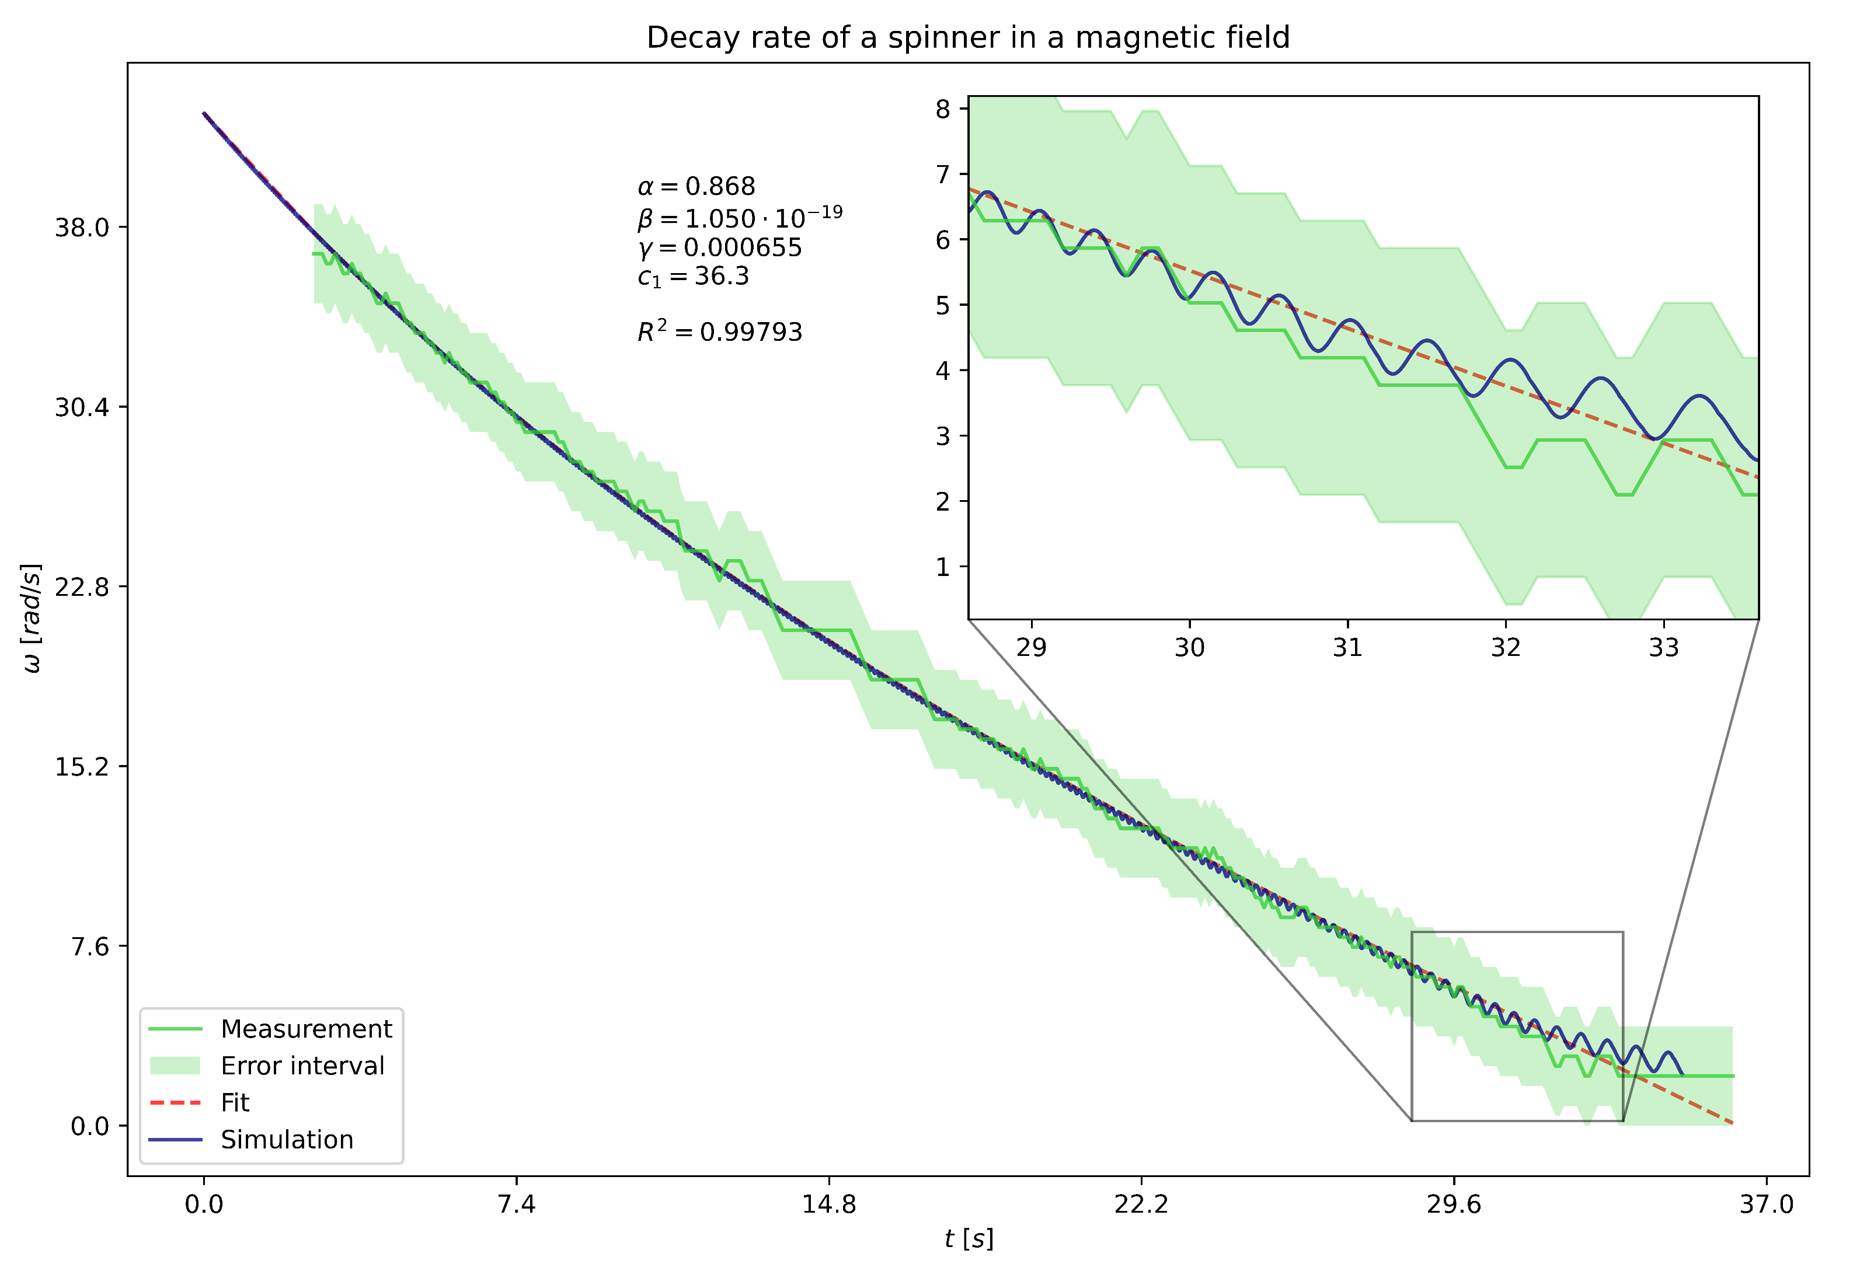
Drag – more result
Additional information
The large magnet is modeled as a single magnetic dipole at its center

Slide 14
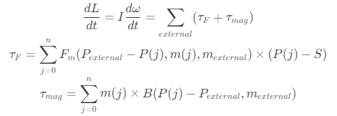
Simulation
Simulation
Takes the initial state as input:
Positions of spinners, initial angles and angular velocities (only in 2D)
Each magnet interacts with every other magnet using the magnetic dipole model
From this we calculate the torques on all the spinners:
The simulation is further improved using RK4
Notes:
Two RK4 passes

Slide 15
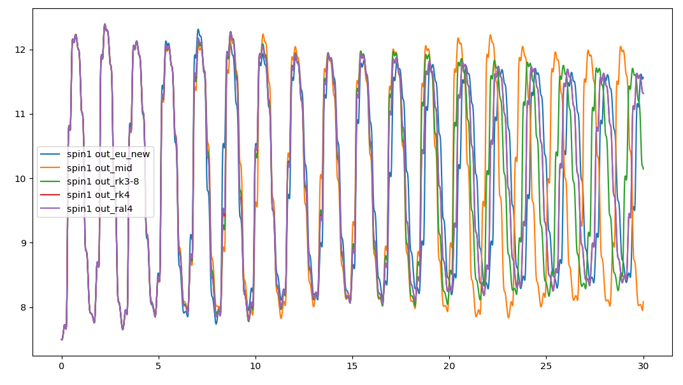
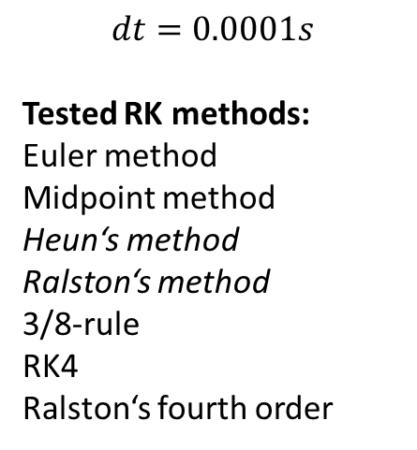
Simulation – methods
Additional information
$$dt=0.0001s$$
Tested RK methods:
Euler method
Midpoint method
Heun‘s method
Ralston‘s method
3/8-rule
RK4
Ralston‘s fourth order
Notes:
Two RK4 passes

Slide 16
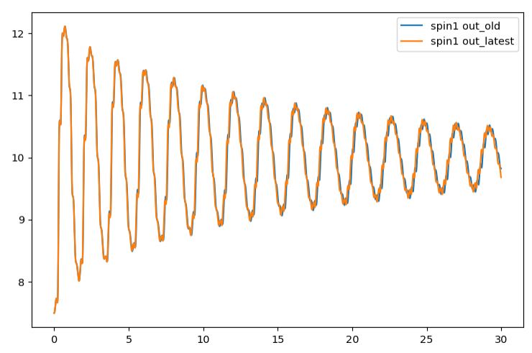
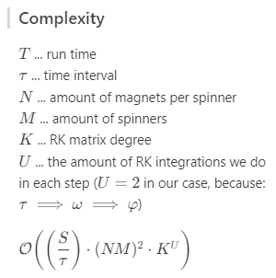
Simulation – methods
Additional information
Single RK4 pass (blue) versus
Double RK4 pass (orange)
Notes:
Two RK4 passes

Slide 17
Magnetic coupling theory
Driven spinner exp.
Two spinners (one driven) rotating at roughly the same velocity => coupling
Gradual changes do not break the coupling; abrupt changes do
The smaller the driving velocity is, the less velocity mismatch is acceptable
Different modes (velocity ratios) are also possible, though even less forgiving
These modes are multiples (2:1, 3:1 …) or integer reciprocals (1:1, 1:2 …) of the driving velocity
Notes:
We observed, that when two spinners (with one being driven by a motor) are rotating at roughly the same velocity, the second spinner becomes coupled and continues keeping the same velocity even during gradual changes

Slide 18
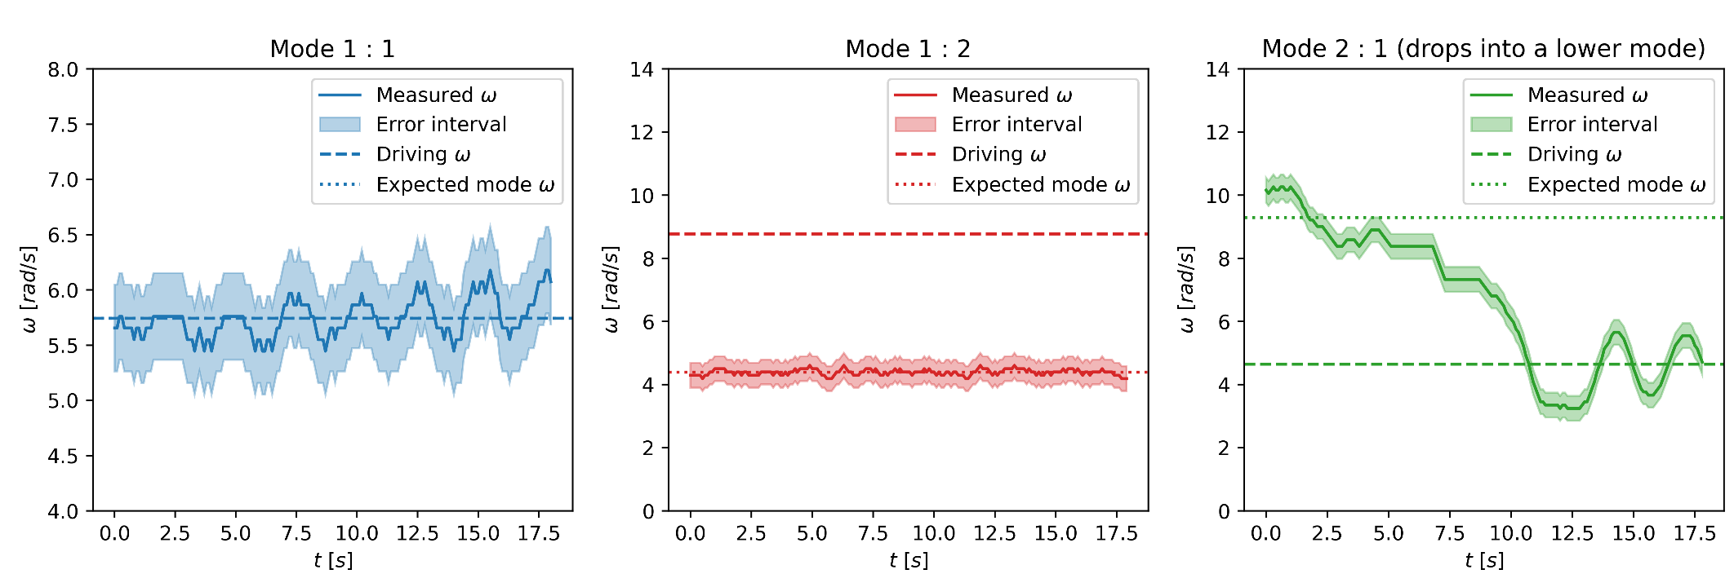
Magnetic coupling results
Driven spinner exp.
Notes:
We observed, that when two spinners (with one being driven by a motor) are rotating at roughly the same velocity, the second spinner becomes coupled and continues keeping the same velocity even during gradual changes
Oscillatioin when dropping into a lower mode

Slide 19

Magnetic coupling results
Driven spinner exp.
Notes:
We observed, that when two spinners (with one being driven by a motor) are rotating at roughly the same velocity, the second spinner becomes coupled and continues keeping the same velocity even during gradual changes

Slide 20
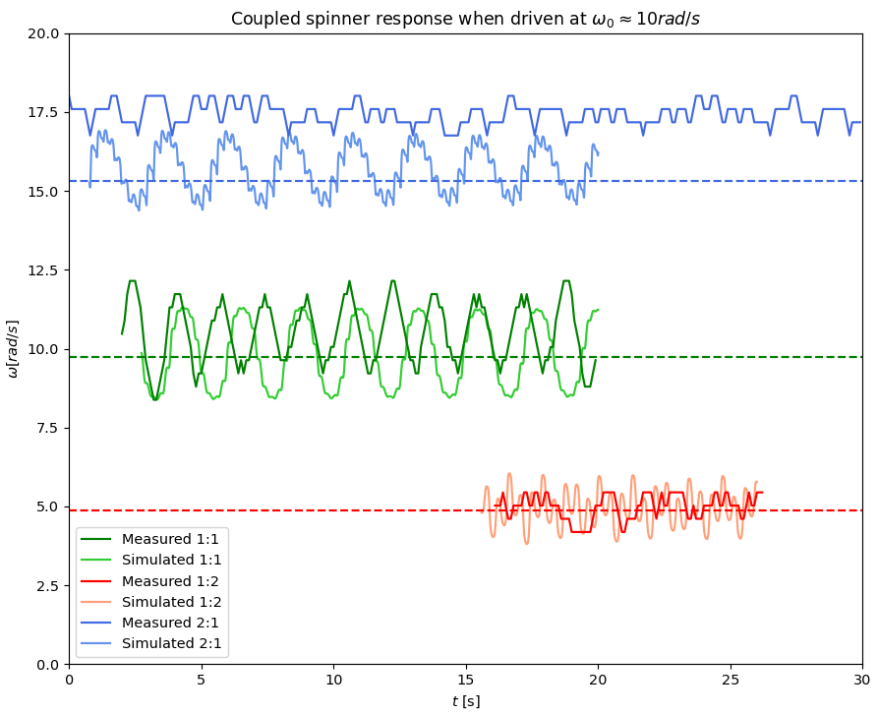
Simulated coupling
Driven spinner exp.
Oscillations around the driving velocity equllibrium were both observed and simulated

Slide 21
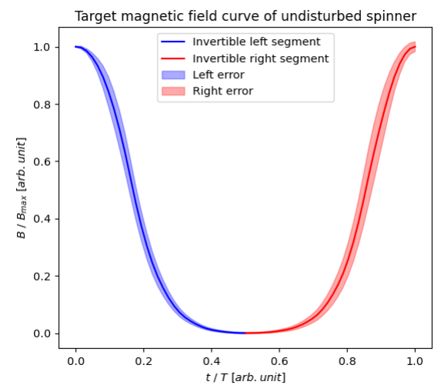
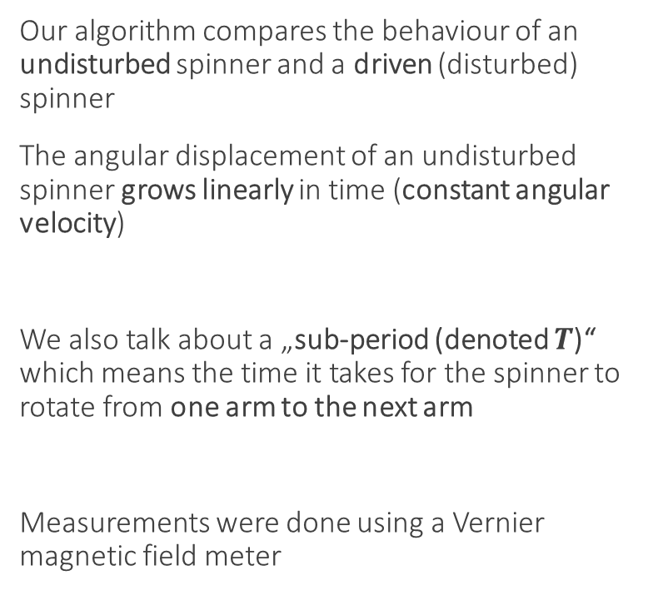
Sub-period behaviour
Additional information
Our algorithm compares the behaviour of an undisturbed spinner and a driven (disturbed) spinner
The angular displacement of an undisturbed spinner grows linearly in time (constant angular velocity)
We also talk about a „sub-period (denoted $T$)“ which means the time it takes for the spinner to rotate from one arm to the next arm
Measurements were done using a Vernier magnetic field meter

Slide 22
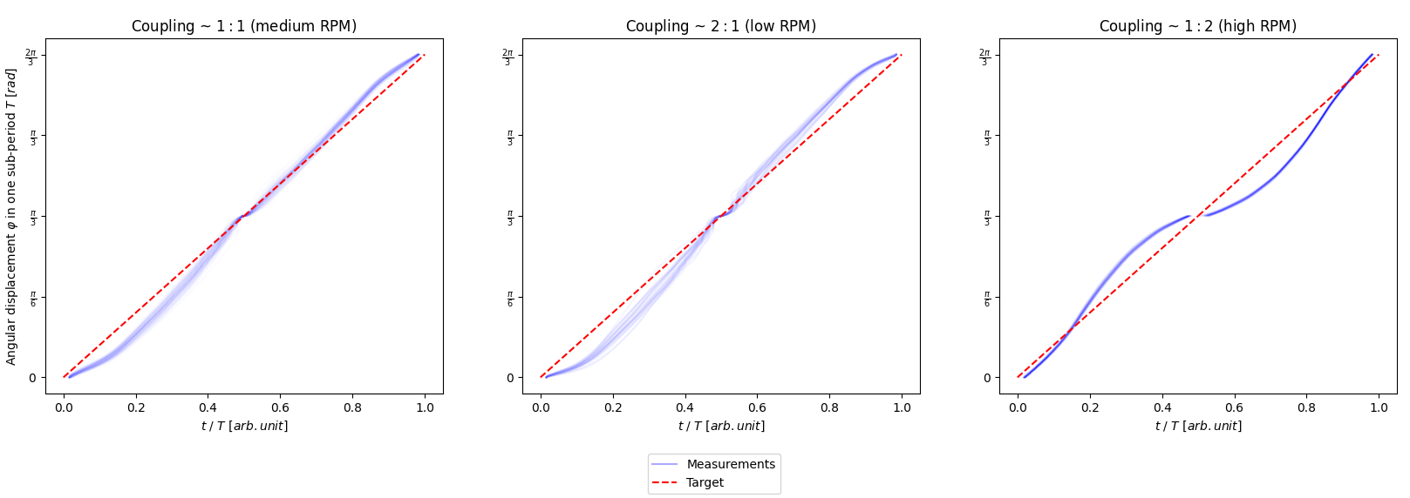
Sub-period behaviour results
Additional information

Slide 23
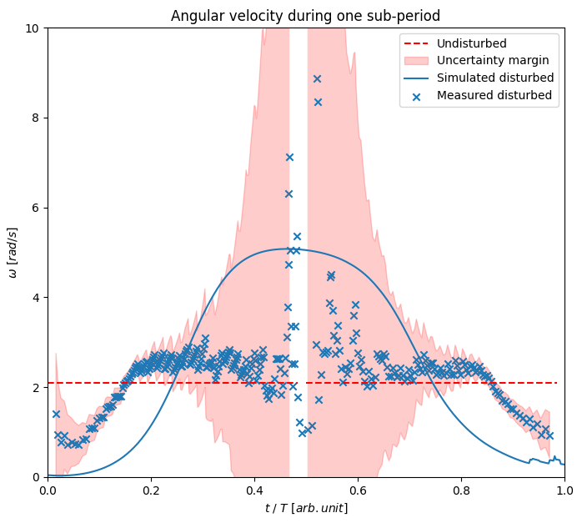
Sub-period behaviour results
Additional information
The extremely high error is due to the algorithm used, which has high uncertainty when the tangent is close to 0
Many other phenomena, like the rattling of the bearing, might be having effect on the real velocity during one sub-period => simulation and measurement doesn‘t match up too well

Slide 24
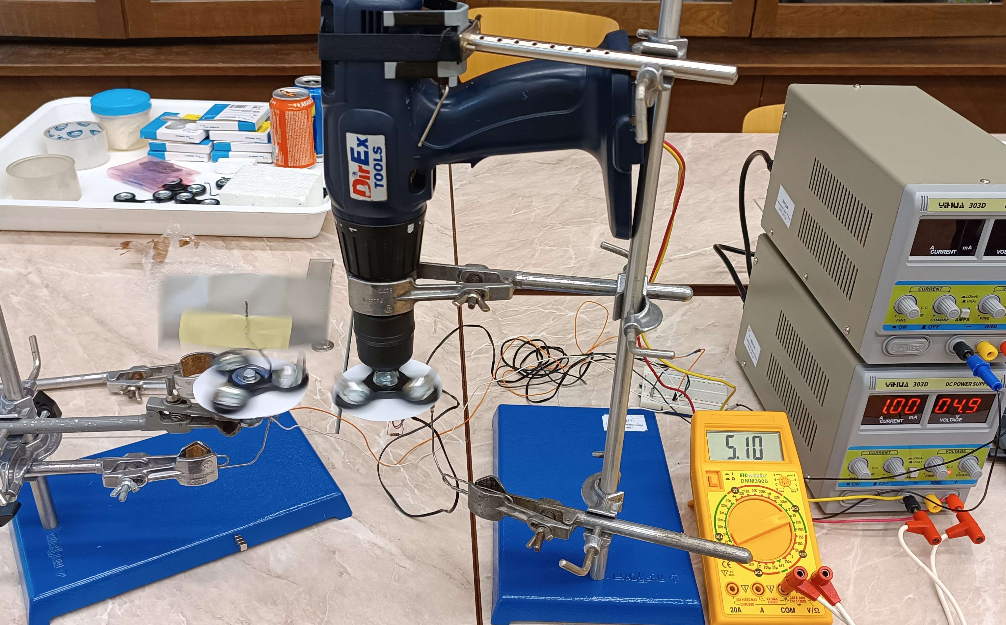
Torque transfer
Driven spinner exp.
The driven spinner has a metal plate added to it to increase air resistance
Measuring the transferred torque from the maximum angular velocity, at which the spinners stay coupled

Slide 25
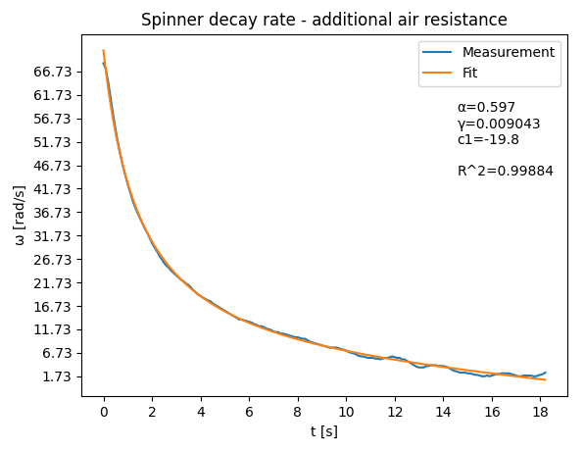
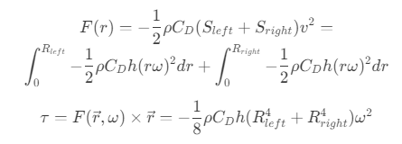
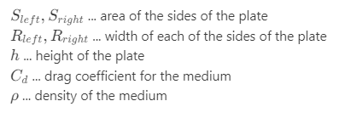

Torque transfer
Driven spinner exp.
The $γ$ parameter has increased tenfold after adding the resisitive plate
A naive air drag model could also be devised like so:

Slide 26
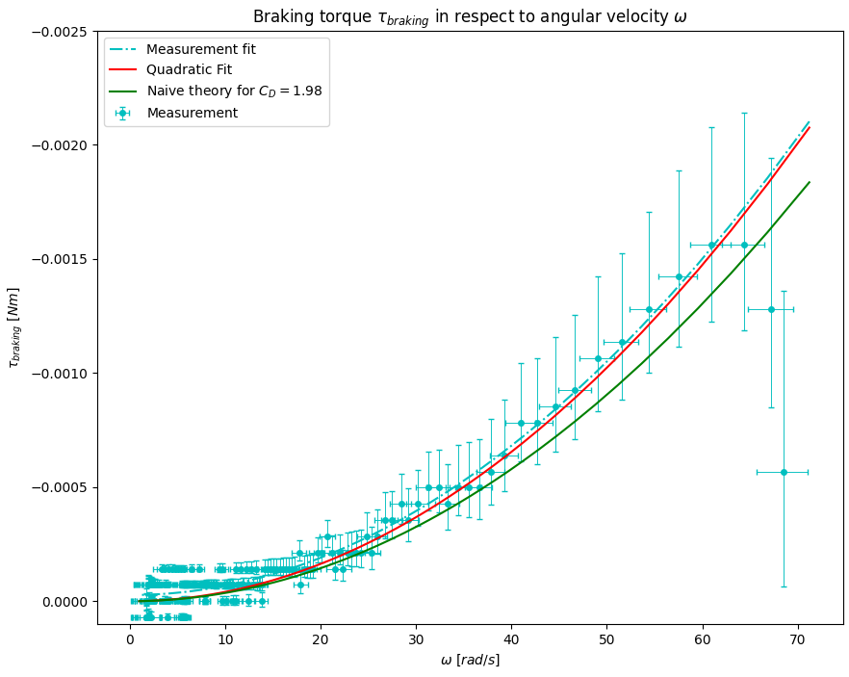
Torque transfer - results
Driven spinner exp.
The braking torque grows quadratically in respect to angular velocity
The naive air drag model is not far off
We can use this to get the torque transferred to the coupled spinner

Slide 27
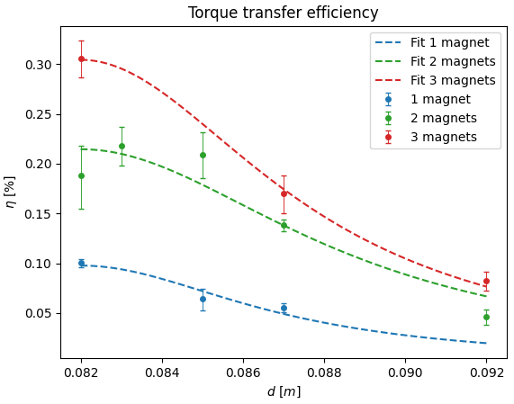
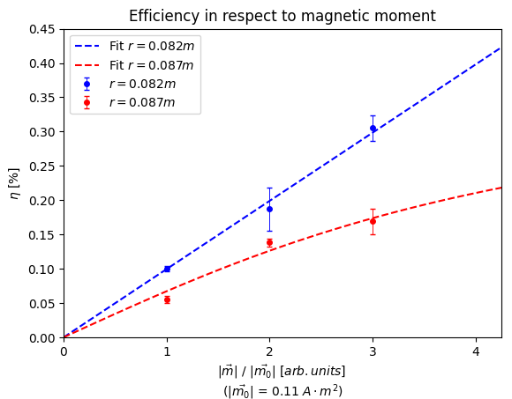
Torque transfer efficiency
Driven spinner exp.
We measured the transferred torque in respect to: spinner to spinner distance, magnet count
The efficiency is very low (<1%)

Slide 28
Torque transfer efficiency
Driven spinner exp.
Some of the reasons, why the efficiency is so low:
In normal magnetic transmissions, alternating pole-pairs are used instead of individual magnets with the same orientation
The magnetic fields are not directed in any way (magnetic field circuits)
The torque on the magnetic moments in the vertical orientation is always zero – changing the orientation could improve the efficiency
The magnets are only repelling eachother, which keeps them at high potential energies, thus destabilizing the system

Slide 29
Magnetic transmissions
Magnetic transmissions

Slide 30
Summary
Summary
We measured the moment of inertia of our spinners
We measured the remanent magnetization of our magnets
We modeled the effects of drag and confirmed our model with measurements:
We successfully observed, sustained and simulated the magnetic coupling of spinners
We have a working simulation, which we‘ve compared with measurements

